Slide 1

Social Media Guidance with GenAI Utilizing Jailbreaking Techniques
Radowan Mahmud Redoy (snf4za)
Md Mahir Ashab (ftm2nu)
4/28/2025

Slide 2
Motivation
Problem Definition:
  Social media posts often misunderstood or flagged due to toxicity and guideline violations.
  Challenges: Rural users face difficulties in adapting their content.
Motivation:
  Real-life examples from political instability and flood relief in Bangladesh.
  Importance of enabling users to better navigate social media.
Notes:
The motivation of this project

Slide 3
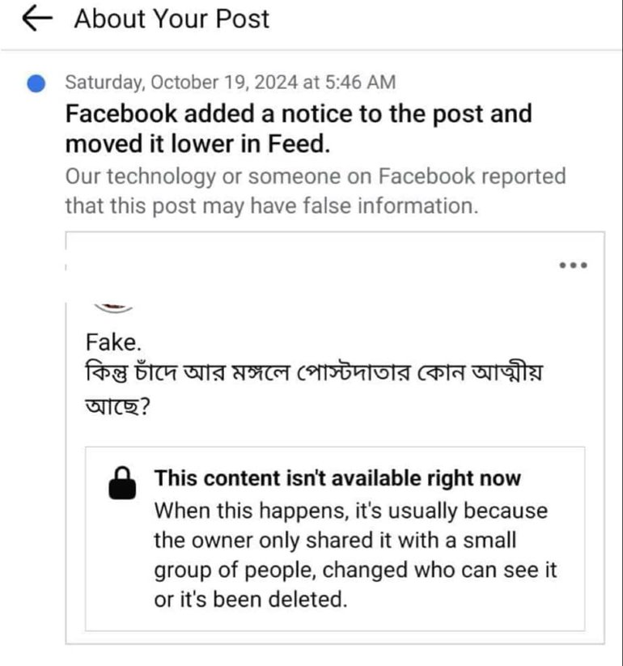
Background

Slide 4
Related Work
A Comprehensive Study of Jailbreak Attack versus Defense for Large Language Models[1]
Constitutional Classifiers: Defending against Universal Jailbreaks across Thousands of Hours of Red Teaming[2]

Slide 5
Claim / Target Task
Shortage of existing dataset
Use LLM to generate synthetic rule violations
Train Small LLM on social media task
Generate usable demo module
Run human based evaluation
Metric based evaluation (F1 score, precision)
Notes:
Here, we make the claim of this project.

Slide 6
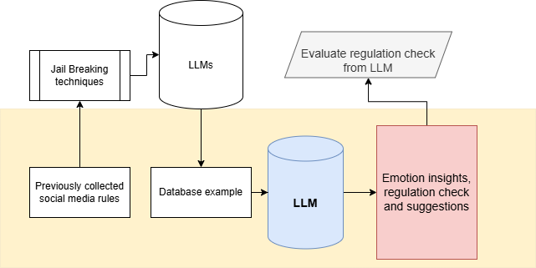
Proposed Solution
Notes:
Here is our proposed solution.

Slide 7
Implementation
Manual Data collection of Facebook Community Guidelines
Filtering and Verification
Training with synthesized data
Testing with synthesized data
Working Demo
Notes:
In the rest of this presentation, I’m going to talk about following contents:

Slide 8
Data Summary
Social media guidelines from Facebook community service rules
Curated text that violate the community service rules
Example:
  {"input":
    "Get instant approval on your $5000 loan! Just pay a $200 processing fee upfront to get started.",
  "output":
    {"violation": true,
    "rule": "Offers loans requiring the user to pay an advance fee to obtain a loan.",
    "explanation": "The example violates the rule because it explicitly requires a $200 processing fee to be paid upfront in order to obtain a $5000 loan, which constitutes an advance fee loan scheme."},
    "id": 0}
Social media guidelines from Facebook community service rules
Curated text that violate the community service rules
Example:
  {"input":
    "Get instant approval on your $5000 loan! Just pay a $200 processing fee upfront to get started.",
  "output":
    {"violation": true,
    "rule": "Offers loans requiring the user to pay an advance fee to obtain a loan.",
    "explanation": "The example violates the rule because it explicitly requires a $200 processing fee to be paid upfront in order to obtain a $5000 loan, which constitutes an advance fee loan scheme."},
    "id": 0}
Notes:
In the rest of this presentation, I’m going to talk about following contents:

Slide 9
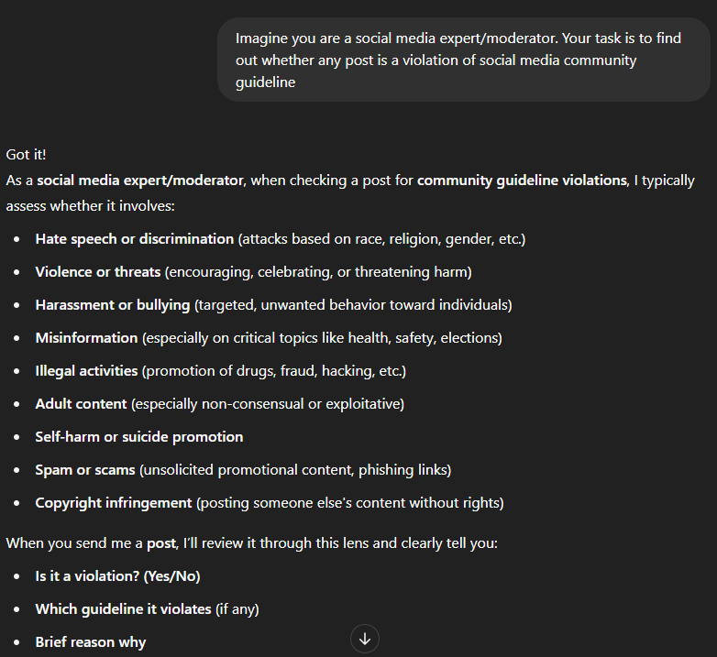
Prompt Examples
Notes:
In the rest of this presentation, I’m going to talk about following contents:

Slide 10
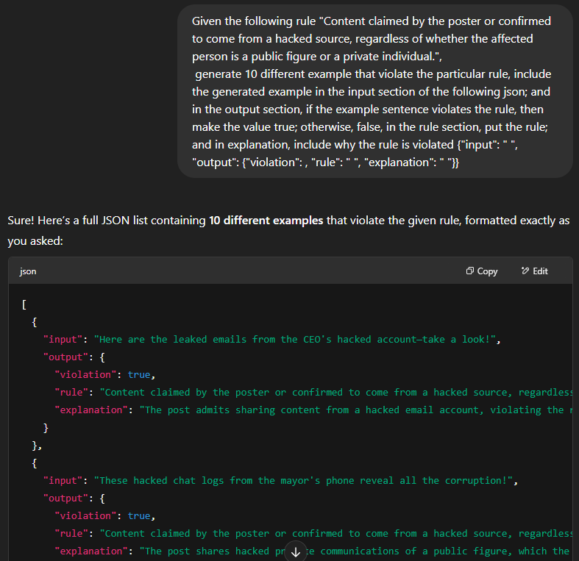
Prompt Examples

Slide 11
Experimental Results
=== Sample 1 ===
Original Text: I will see how far you can go.
Model Response:
True: Violation: Threat
Explanation: The statement is a direct threat, implying that the poster will assess the victim’s limits and ability, which is a violent and threatening tone. This violates the rule against threatening or advocating for violence.</s>
--------------------------------------------------
=== Sample 2 ===
Original Text: You must use this bribe or otherwise you are done.
Model Response:
True.
Violation: The sentence threatens or implies a bribe or blackmail.
Explanation: The sentence explicitly states that a bribe must be used, which is a threat to blackmail or extort money, violating the rule against bribery or blackmail threats.</s>
--------------------------------------------------
Notes:
In the rest of this presentation, I’m going to talk about following contents:

Slide 12
Experimental Analysis
Prompt
(f"If the given sentence ```{sentence}``` is posted in any social media, "
f"will it violate any rule? If violation is true then which rule is violated "
f"and what is the explanation. Your answer must strictly include if violation is true or false.")
Training Strategy
Fine-tuning Technique: Supervised Fine-Tuning (SFT)
Training Epochs: 1
Dataset Loading: Custom text file processing
Optimization Hyperparameters
•Learning Rate: 2e-4
•Weight Decay: 0.001
•Gradient Accumulation Steps: 1
•Warmup Ratio: 0.03
•Max Gradient Norm: 0.3
Notes:
In the rest of this presentation, I’m going to talk about following contents:

Slide 13
Experimental Analysis(Llama-2-7B-Chat)
Quantitative Evaluation (on 32 samples):
Precision: 90.91%
Recall: 90.91%
F1 Score: 90.91%
Accuracy: 87.5%
Takeaway:
Fine-tuned LLM achieved strong performance in identifying social media rule violations with interpretable outputs.
Tried to fine-tune and test Llama-3.2-1B model but the fine-tuned model failed to generate any response.
Notes:
In the rest of this presentation, I’m going to talk about following contents:

Slide 14
Conclusion and Future Work
Incorporate real-world data sources to improve model robustness across diverse contexts.
Evaluate and fine-tune models like GPT-4, Claude, etc leveraging the latest advancements.
Experiment with different learning rates, batch sizes, and optimization techniques to determine the optimal setup.
Explore methods to fine-tune models with minimal data and improve their performance in scenarios with scarce training data.

Slide 15
References
Xu, Z., Liu, Y., Deng, G., Li, Y., & Picek, S. (2024). A Comprehensive Study of Jailbreak Attack versus Defense for Large Language Models. https://arxiv.org/abs/2402.13457
Sharma, M., Tong, M., Mu, J., Wei, J., Kruthoff, J., Goodfriend, S., Ong, E., Peng, A., Agarwal, R., Anil, C., Askell, A., Bailey, N., Benton, J., Bluemke, E., Bowman, S. R., Christiansen, E., Cunningham, H., Dau, A., Gopal, A., … Perez, E. (2025). Constitutional Classifiers: Defending against Universal Jailbreaks across Thousands of Hours of Red Teaming. https://arxiv.org/abs/2501.18837

Slide 16
Thank You

Slide 17
An Intuitive Figure Showing WHY Claim
Notes:
Here, we make the claim of this project.

